Slide 1
Logic Programming Paradigm

Slide 2
Logic Programming Paradigm
Sub Topics
Definition
First-class function, Higher-order function, Pure functions, Recursion
Packages: Kanren, SymPy
PySWIP, PyDatalog
Other languages: Prolog, ROOP, Janus

Slide 3
Introduction
It can be an abstract model of computation.
Solve logical problems like puzzles, series
Have knowledge base which we know before and along with the question
Specify knowledge and how that knowledge is to be applied through a series of rules
In logic programming, the common approach is to apply the methods of resolution and unification
Knowledge is given to machine to produce result. Exp : AL and ML code

Slide 4
Introduction
The Logical Paradigm takes a declarative approach to problem-solving.
Various logical assertions about a situation are made, establishing all known facts. Then queries are made.
The role of the computer becomes maintaining data and logical deduction.
Execution of a logic program is a theorem proving process; that is, computation is done by logic inferences
Prolog ( PROgramming in LOGic) is a ) is a representative logic language
Exp : Prolog, ROOP, Janus

Slide 5
What is a logic ?
A logic is a language.
It has syntax and semantics.
More than a language, it has inference rules.
Syntax:
The rules about how to form formulas;
This is usually the easy part of a logic.
Semantics:
about the meaning carried by the formulas,
mainly in terms of logical consequences.
Proof Theory
Proof Theory describe correct ways to derive

Slide 6
Features of Logical paradigms
Computing takes place over the domain of all terms defined over a “universal” alphabet.
Values are assigned to variables by means of automatically generated substitutions, called most general unifiers.
These values may contain variables, called logical variables.
The control is provided by a single mechanism: automatic backtracking.
Strength - simplicity and Conciseness
Weakness –
has to do with the restrictions to one control mechanism
use of a single data type.

Slide 7
History of Logic Programming (LP)
Logic Programming has roots going back to early AI researchers like John McCarthy in the 50s & 60s
Alain Colmerauer (France) designed Prolog as the first LP language in the early 1970s
Bob Kowalski and colleagues in the UK evolved the language to its current form in the late 70s
It’s been widely used for many AI systems, but also for systems that need a fast, efficient and clean rule based engine
The prolog model has also influenced the database community –
Exp datalog

Slide 8
General Overview
Programs written in logic languages consist of declarations that are actually statements, or propositions, in symbolic logic.
One of the essential characteristics of logic programming languages is their semantic
The basic concept of this semantics is that there is a simple way to determine the meaning of each statement, and it does not depend on how the statement might be used to solve a problem.

Slide 9
Concepts of logic paradigm and theoretical background
Includes both theoretical and fully implemented languages
They all share the idea of interpreting computation as logical deduction.
Notation Algorithm = Logic + Control
Logic Programming uses facts and rules for solving the problem.
That is why they are called the building blocks of Logic Programming.
Facts
Actually, every logic program needs facts to work with so that it can achieve the given goal.
Facts basically are true statements about the program and data.
Exp : Delhi is the capital of India.
Rules
Constraints which allow us to make conclusions about the problem domain.
Basically written as logical clauses to express various facts.
Exp if we are building any game then all the rules must be defined.

Slide 10
Parts of Logical programming
A series of definitions/declarations that define the problem domain
Statements of relevant facts
Statement of goals in the form of a query

Slide 11
Advantages
The system solves the problem, so the programming steps themselves are kept to a minimum;
Proving the validity of a given program is simple.

Slide 12
Perspectives on logic programming
Computations as Deduction
Theorem Proving
Non-procedural Programming
Algorithms minus Control
A Very High Level Programming Language
A Procedural Interpretation of Declarative Specifications

Slide 13
Computation as Deduction
Logic programming offers a slightly different paradigm for computation: computation is logical deduction
It is raining -> Road is wet
Current logic programming languages use first order logic (FOL) which is often referred to as first order predicate calculus (FOPC).
The first order refers to the constraint that we can quantify (i.e. generalize) over objects, but not over functions or relations.

Slide 14
Theorem Proving
Logic Programming uses the notion of an automatic theorem prover as an interpreter.
The theorem prover derives a desired solution from an initial set of axioms.
The proof must be a "constructive" one so that more than a true/false answer can be obtained
E.G. The answer to
exists x such that x = sqrt(16)
should be x = 4 or x = -4

Slide 15
Non-procedural Programming
Logic Programming languages are non-procedural programming languages
That is, one specifies:
the set of objects involved in the computation
the relationships which hold between them
the constraints which must hold for the problem to be solved
and leaves it up the language interpreter or compiler to decide how to satisfy the constraints

Slide 16
A Declarative Example
Here’s a simple way to specify what has to be true if X is the smallest number in a list of numbers L
1. X has to be a member of the list L
2. There can be list member X2 such that X2<X

Slide 17
Use logic to do reasoning
Example: Given information about fatherhood and motherhood, determine grand parent relationship
E.g. Given the information called facts
John is father of Lily
Kathy is mother of Lily
Lily is mother of Bill
Ken is father of Karen
Who are grand parents of Bill?
Who are grand parents of Karen?

Slide 18
Use logic to do reasoning
Example: Given information about fatherhood and motherhood, determine grand parent relationship
E.g. Given the information called facts
John is father of Lily
Kathy is mother of Lily
Lily is mother of Bill
Ken is father of Karen
Who are grand parents of Bill?
Who are grand parents of Karen?
Bill
Lily
John
Kathy
Karen
Ken

Slide 19
Example
Domains
being = symbol
Predicates
L(x,y): % X lives in Y
L(Mary, Austin) % Mary lives in , Austin
Clauses
P % Present
¬p %Not Present

Slide 20
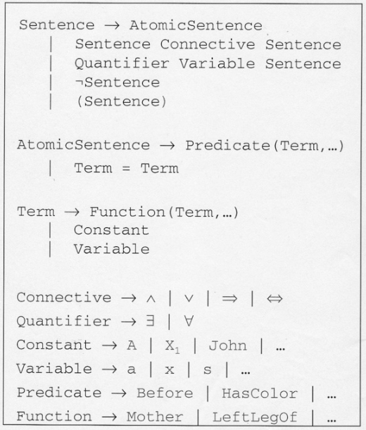
Logic Operators

Slide 21
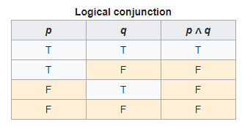
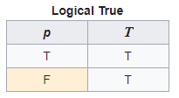
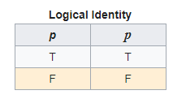
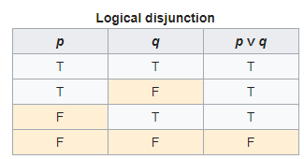
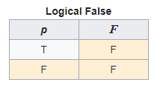
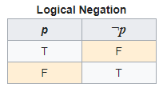
Truth Tables

Slide 22
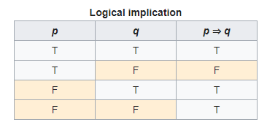
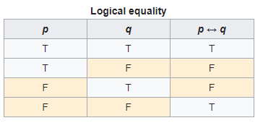
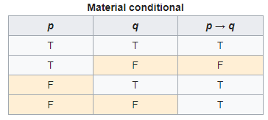
Truth Tables

Slide 23
Example Statements
Consider the following knowledge:
Bob is Fred’s father → father(Bob, Fred)
Sue is Fred’s mother → mother(Sue, Fred)
Barbara is Fred’s sister → sister(Barbara, Fred)
Jerry is Bob’s father → father(Jerry, Bob)
And the following rules:
A person’s father’s father is the person’s grandfather
A person’s father or mother is that person’s parent
A person’s sister or bother is that person’s sibling
If a person has a parent and a sibling, then the sibling has the same parent
Notes:
The rules at the bottom would be read as:
if x is y’s father and y is z’s father than x is z’s grandfather
if x is y’s father than x is y’s parent
if x is y’s mother than x is y’s parent
The terms grandfather, mother, father and parent have no intrinsic meaning in Prolog, they are merely symbols that we as humans would interpret. A logic system could just as easily have been written as
pie(x, z) ← goober(x, y) and piglet(y, z)
Also note that we as humans add the interpretation for the relationship between parameters – for instance, a person could just as easily have interpreted the first rule to be that if y is the father of x and z is the father of y, then z is the grandfather of x. However, we usually apply parameters in a left-to-right manner.

Slide 24
Example Statements
These might be captured in first-order predicate calculus as:
x, y, z : if father(x, y) and father(y, z) then grandfather(x, z)
x, y : if father(x, y) or mother(x, y) then parent(x, y)
x, y : if sister(x, y) or brother(x, y) then sibling(x, y) and sibling(y, x)
x, y, z : if parent(x, y) and sibling(y, z) then parent(x, z)
We would rewrite these as
grandfather(x, z) → father(x, y) and father(y, z)
parent(x, y) → father(x, y)
parent(x, y) → mother(x, y)
Notes:
The rules at the bottom would be read as:
if x is y’s father and y is z’s father than x is z’s grandfather
if x is y’s father than x is y’s parent
if x is y’s mother than x is y’s parent
The terms grandfather, mother, father and parent have no intrinsic meaning in Prolog, they are merely symbols that we as humans would interpret. A logic system could just as easily have been written as
pie(x, z) ← goober(x, y) and piglet(y, z)
Also note that we as humans add the interpretation for the relationship between parameters – for instance, a person could just as easily have interpreted the first rule to be that if y is the father of x and z is the father of y, then z is the grandfather of x. However, we usually apply parameters in a left-to-right manner.

Slide 25
Packages: Kanren
Provides a way to simplify the code for business logic.
Express the logic in terms of rules and facts.
The following command will help you install kanren −
pip install kanren

Slide 26
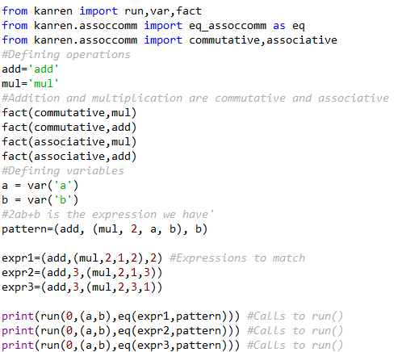

Matching mathematical expressions

Slide 27
SymPy Overview
Simplification
simplify
Polynomial/Rational Function Simplification
Trigonometric Simplification
Powers
Exponentials and logarithms
Special Functions
Example: Continued Fractions
Calculus
Derivatives
Integrals
Limits
Series Expansion
Finite differences
Solvers
A Note about Equations
Solving Equations Algebraically
Solving Differential Equations
Matrices
Basic Operations
Basic Methods
Matrix Constructors
Advanced Methods
Possible Issues
Reference:
https://www.geeksforgeeks.org/python-getting-started-with-sympy-module/
https://docs.sympy.org/latest/tutorial/index.html

Slide 28
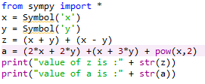

SymPy module
SymPy is a Python library for symbolic mathematics.
It aims to become a full-featured computer algebra system (CAS)
While keeping the code as simple as possible in order to be comprehensible and easily extensible.
SymPy is written entirely in Python.
Installing sympy module:
Pip install sympy

Slide 29
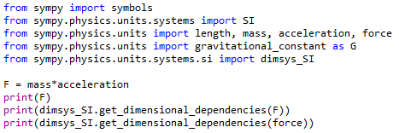

SymPy Example

Slide 30
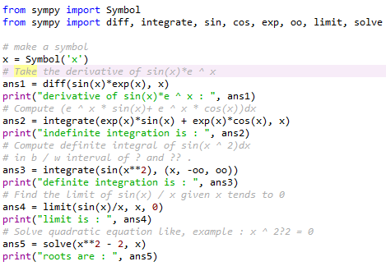

Find derivative, integration, limits, quadratic equation

Slide 31
Datalog Concepts
pyDatalog is a powerful language with very few syntactic elements, mostly coming from Python :
Variables and expressions
Loops
Facts
Logic Functions and dictionaries
Aggregate functions
Literals and sets
Tree, graphs and recursive algorithms
8-queen problem
Reference
https://sites.google.com/site/pydatalog/Online-datalog-tutorial

Slide 32
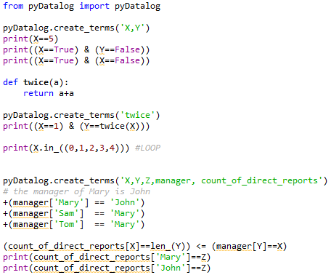
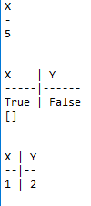

Slide 33
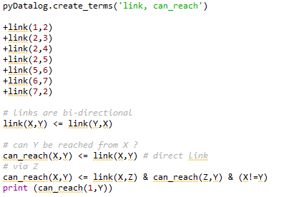
1
2
5
3
7
4
6

Slide 34
PySwip Introduction
PySwip is a Python - SWI-Prolog bridge enabling to query SWI-Prolog in your Python programs.
It features an (incomplete) SWI-Prolog foreign language interface, a utility class that makes it easy querying with Prolog and also a Pythonic interface.
Since PySwip uses SWI-Prolog as a shared library and ctypes to access it,
it doesn't require compilation to be installed.
Reference :
https://pypi.org/project/pyswip/

Slide 35
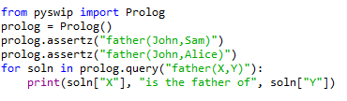

Example

